Slide 1



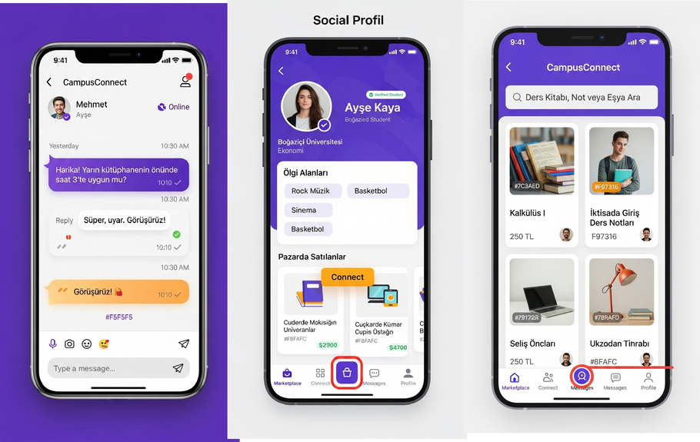
CampusConnect: Solution Overview
Empowering Turkish University Students with a Hyper-Local C2C and Social Platform
Step 1: Goals & MVP
Value Proposition
Goals: Addresseconomic pressures and social needs of 7.08M Turkish university students in a $27.5B e-commerce market.
MVP: Hyper-local C2C marketplace and social network for cost-
effective transactions and community building in major university hubs.
Differentiation: Tailored for students, hyper-local, low-cost, with integrated social features, unlike high-fee general C2C platforms.
Pain Relievers: Eliminates high commissions (up to 25%) and
shipping costs, addressing 67% inflation and limited budgets (6,000
TRY/month).
Gain Creators: Saves money, generates income via sales, and fosters
community connections.
Feasibility: High smartphone penetration (90%), e-commerce
adoption, and concentrated student base (300,000 in 10 major
universities). Year 1: 15,000 users, 372,250 TRY revenue.
Step 2: Key Features
Hyper-Local C2CMarketplacefor buying/selling used goods
(textbooks, electronics, furniture).
AI-Powered Easy Listing: Snap a photo of an item, and our AI will automatically suggest a title, description, and category, making selling faster and simpler.
Zero/Low-Commission Transactions to maximize student savings.
In-App Social Networking for community engagement and interest groups.
Textbook & Supplies Exchange for affordable academic materials.
Geo-Tagged Listings for university-specific, in-person exchanges.
Premium Social/Dating Features for additional revenue (3.85B TRY
market).
CampusConnect Visual

